Slide 1
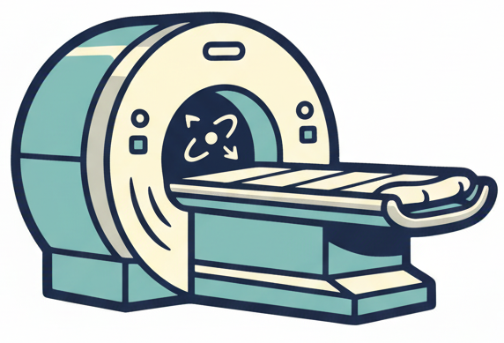

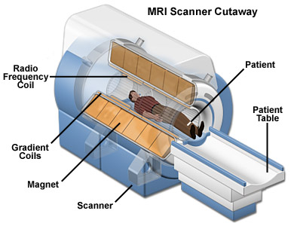
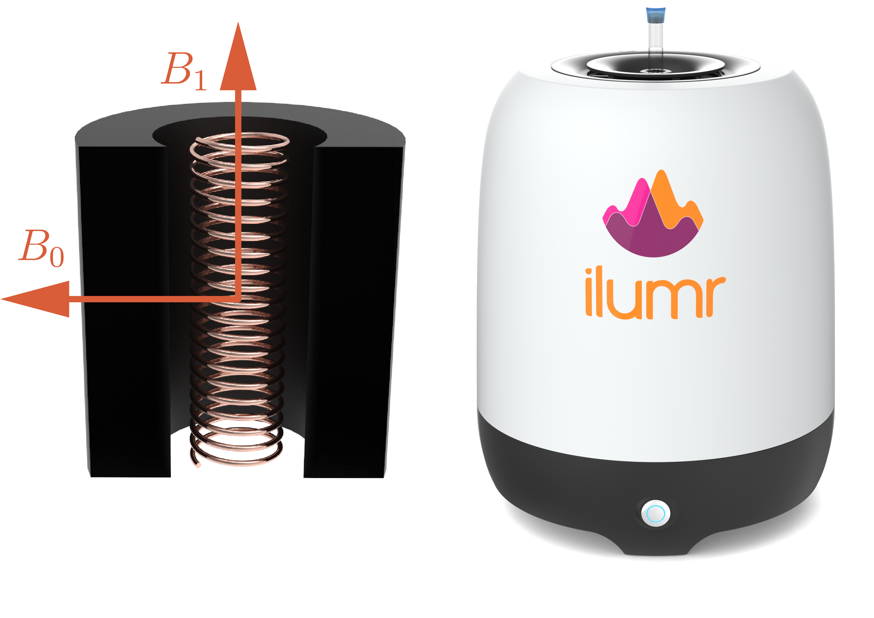
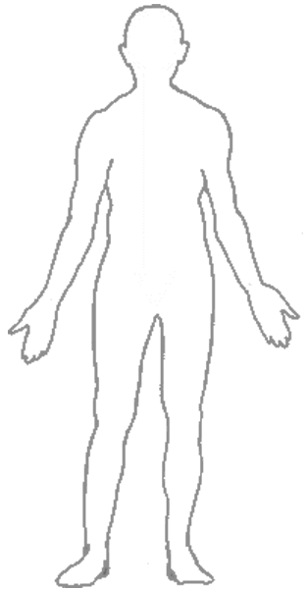






What is MRI and How Does it Work?
MRI uses a powerful magnet and radio waves to take pictures inside of the body
MRI
  Magnetic – uses a very large
  magnetic field, and maps magnetic
  properties
  Resonance – hydrogen atoms
  vibrate at a radio frequency
  Imaging – pictures are created
What does MRI measure?
  Water molecules in the body
  Your body is 80% water
  Magnetic properties of water change between blood and different organs
Is MRI safe?
  It is safe to be scanned over and over with MRI because it uses no radiation
  Bringing magnetic objects into a MRI scanner room is dangerous, these can get stuck to the large magnet
Insides of MRI Machines
$$B_{1}^{+}$$
$$B_{1}^{−}$$
$$B_{0}$$
B₀
B₀
B₀
$$\vec{G}⋅\vec{r}$$
Polarization
Go inside a big magnet
Excitation
Send radio waves into the body
Acquisition
Listen for radio waves coming back out of the body
Spatial Encoding
Make small changes to the magnetic field to create an image

